Slide 1
Pregnancy Discrimination & the New EEOC Guidance with Young v. UPS, Inc. Looming
Presented by:
Robert M. Williams, Jr., Esq.
rwilliams@bakerdonelson.com
Joann Coston-Holloway, Esq.
jholloway@bakerdonelson.com

Slide 2
History
Pregnancy Discrimination Act (“PDA”) – enacted in 1978 to make clear that discrimination based on pregnancy, child birth, or related medical conditions is a form of sex discrimination prohibited by Title VII.
Fundamental Requirements:
Prohibits an employer from discriminating against an employee on the basis of pregnancy, childbirth, or related medical condition; AND
Women affected by pregnancy, childbirth, or related medical conditions must be treated the same as other persons not so affected but similar in their ability to work.

Slide 3
EEOC Takes a Position (albeit divided)
In 1997, 3,900 EEOC Charges were filed alleging pregnancy discrimination.
In 2013, 5,342 EEOC Charges were filed.
With an increasing number of charges, on July 14, 2014, the EEOC issued guidance on the PDA.

Slide 4
Extent of PDA Coverage
Title VII as amended by the PDA, prohibits discrimination based on the following:
Current Pregnancy
Past Pregnancy
Potential or Intended Pregnancy
Medical Conditions Related to Pregnancy or Childbirth

Slide 5
Current Pregnancy
Discrimination occurs when an employer refuses to hire, fires, or takes any other adverse action against a woman because she is pregnant, without regard to her ability to perform the duties of the job.
Critical Inquiry – Employer’s Knowledge of Pregnancy
No Liability When No Knowledge of Pregnancy

Slide 6

Common Mistakes – Stereotypes & Assumptions
Adverse treatment of pregnant women often arises from stereotypes and assumptions about their job capabilities and commitment to the job.
Examples:
  Maria – “Your body is trying to tell you something.”
  Darlene – Too risky, that you will decide to stop working.

Slide 7
Past Pregnancy – “The Fourth Trimester”
PDA does NOT restrict claims to those based on current pregnancy.
A causal connection between a claimant’s past pregnancy and the challenged action more likely will be found if there is close timing between the two.
Lack of close timing – Employers still are not in the clear.
New Caregiver Responsibilities – Violation of Title VII may be established where there is evidence that the employee’s gender or another protected characteristic motivated the employer’s action.

Slide 8

Potential or Intended Pregnancy
SCOTUS has held Title VII “prohibits an employer from discriminating against a woman because of her capacity to become pregnant.”
  Discrimination Based on Reproductive Risk – Battery Manufacturing Company
  Discrimination Based on Intention to Become Pregnant – Interview Woes – No Family Questions!
  Discrimination Based on Infertility Treatment – No penalty for time off for infertility treatments.
  Discrimination Based on Use of Contraception

Slide 9

Medical Condition Related to Pregnancy & Childbirth
An Employer may not discriminate against a woman with a medical condition relating to pregnancy or childbirth and must treat her the same as others who are similar in their ability or inability to work but are not affected by pregnancy, childbirth, or related medical condition.
  Example: Sherry – Employed under a year, policy provides for 4 weeks of medical leave, terminated after 4 weeks while out on pregnancy related medical condition.

Slide 10
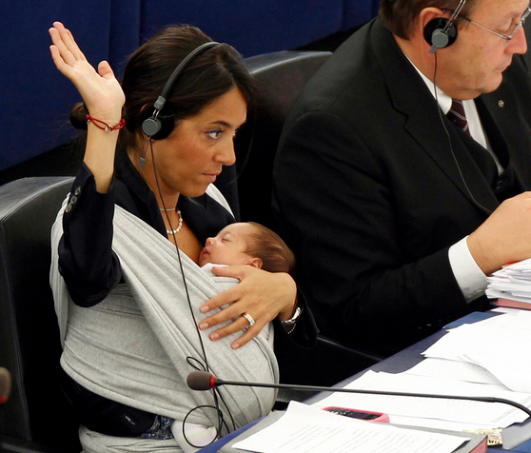
Breastfeeding
Employee must have the same freedom to address lactation-related needs that she and her co-workers would have to address other similarly limiting medical conditions.
  Example: Rearrangement of breaks
  Patient Protection and Affordable
  Care Act – Requires employers
  to provide reasonable break time
  and a private place for hourly
  employees who are breastfeeding
  to express milk.

Slide 11
Who is Similarly Situated?
MEN AND NON-PREGNANT WOMEN – Title VII requires that individuals affected by pregnancy, childbirth, or related medical condition be treated the same for all employment related purposes as to other persons not so affected but similar in their ability or inability to work.

Slide 12
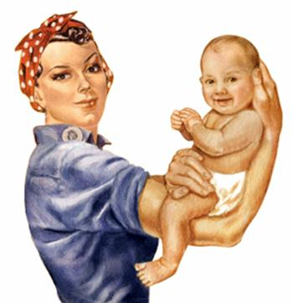
Disparate Treatment
Harassment
Workers with Caregiving Responsibilities – Treating employee with new baby less favorably falls outside of the PDA. However, may be actionable if based on sex.
Bona Fide Occupational Qualification
Defense – EXTREMELY narrow
exception to general prohibition
on discrimination on basis of sex.

Slide 13
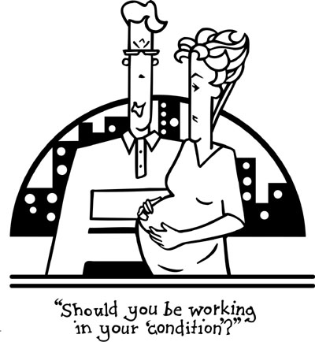
Disparate Impact
Title VII is violated if a facially neutral policy has a disproportionate adverse effect on women affected by pregnancy, childbirth, or related medical conditions and the employer cannot show the policy is job related for the position in question and consistent with business necessity.
  Example: Carol – Applied for a warehouse
  job but can’t lift 50 pounds because she is
  pregnant. She is not hired.
    Employer must show:
    (1) Requirement Job Related
      (2) Consistent with Business Necessity

Slide 14

Forced Leave?
Employers may not compel an employee to take leave because she is pregnant, so long as she is able to perform her job.
Example: Lena – worked for a janitorial service. Discloses she’s pregnant and boss tells her she has to stop working. Discharge due to stereotypes about pregnancy.

Slide 15
The EEOC’s Controversial Gambit
Per the EEOC Guidance an employer is obligated to treat a pregnant employee temporarily unable to perform the functions of her job the same as it treats other employees similarly unable to perform their jobs, whether by providing modified tasks, alternative assignment, leave, or fringe benefits.

Slide 16
The EEOC’s Controversial Gambit (continued)
Thus, the EEOC contends, an employer may not refuse to treat a pregnant worker the same as other employees who are similar in their ability or inability to work by relying on a policy that makes distinctions based on the source of an employee’s limitations (e.g., a policy of providing light duty only to workers injured on the job.)

Slide 17
The EEOC’s Controversial Gambit (continued)
Under this Guidance, the EEOC is taking the position that pregnant employees must be accommodated the same as other employees in the workplace are accommodated who are similar in their ability to work.

Slide 18
The EEOC’s Controversial Gambit (continued)
Requiring employers to accommodate pregnant employees is not expressly stated in the PDA – or for that matter Title VII or even the ADA. A pregnant employee does not have a disability within the meaning of the ADA.

Slide 19
The EEOC’s Controversial Gambit (continued)
So, employers must accommodate pregnant employees with restrictions or requirements even if they are not disabled under the ADAAA.
This novel position of the EEOC is the anticipated focus of the Supreme Court’s decision in Young v. United Parcel Service.

Slide 20
The Peggy Young Case
Peggy Young worked as an air driver for UPS out of the Landover, Maryland facility.
In July 2006, Young requested a leave of absence to undergo a third round of in vitro fertilization.

Slide 21

The Peggy Young Case (continued)
She became pregnant and extended her leave.
In September 2006, Young’s midwife wrote a note limiting Young to lifting no more than 20 pounds.

Slide 22

The Peggy Young Case (continued)
In the fall of 2006 Young asked to return to work with her lifting limitation light duty.
UPS defined as an essential job function
for drivers “the ability to lift, lower, push,
pull…”packages weighing up to 70 pounds.

Slide 23

The Peggy Young Case (continued)
Pursuant to its collective bargaining agreement UPS only allowed light duty in the following circumstances:
  Employees with limitations arising from on the job injuries;
  Employees considered “disabled” under the ADA; and
  Employees who temporarily lost DOT certification.

Slide 24

The Peggy Young Case (continued)
                Thus, Young was ineligible for light duty work for any limitations arising from her pregnancy. She also could not perform the essential elements of her job.

Slide 25
The Peggy Young Case (continued)
UPS left Young on unpaid leave until after the birth of her child, during which time her health insurance lapsed.
Young sued claiming that UPS’s policy of providing light duty to some employees but not to pregnant employees violated the PDA’s language to treat pregnant employees the same “as other persons not so affected but similar in their ability or inability to work.”

Slide 26

The Peggy Young Case (continued)
The District Court denied Young’s claims and she appealed to the Court of Appeals for the Fourth Circuit.
The Court of Appeals affirmed the decision of the district court in favor of UPS.

Slide 27

The Peggy Young Case (continued)
The court noted:
  UPS’s policy was pregnancy neutral or “pregnancy-blind.”
  Young argued that the PDA created a new cause of action distinct from Title VII sex discrimination by compelling employers to treat pregnant employees more favorably than male and female (non-pregnant) employees with restrictions resulting from non work injuries.

Slide 28

The Peggy Young Case (continued)
                Congress placed the entirety of the PDA into the “Definitions” section of Title VII:
                The terms “because of sex” or “on the basis of sex” include, but are not limited to, because of or on the basis of pregnancy, childbirth, or related medical conditions; and women affected by pregnancy, childbirth, or related
                medical conditions shall be treated
                the same for all employment-related
                purposes, including receipt of
                benefits under fringe benefit
                programs, as other persons
                not so affected but similar in
                their ability or inability to work…

Slide 29
The Peggy Young Case (continued)
There are two clauses in the above definition.
“Confusion arises when trying to reconcile language in the first clause suggesting the PDA simply expands the category of sex discrimination (without otherwise altering Title VII), and language in the second clause suggesting the statute requires different – perhaps even preferential-
treatment for pregnant workers.”

Slide 30
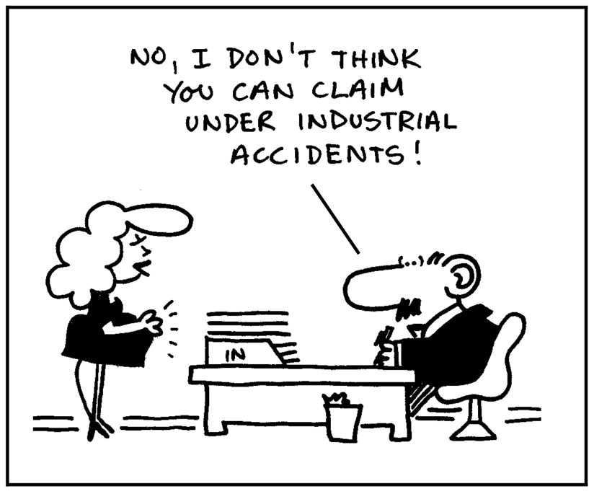
The Peggy Young Case (continued)
The Court held:
  The PDA’s placement in the definitional section of Title VII, and grounding it within the confines of sex discrimination, make clear that it does not create a distinct and independent clause of action.

Slide 31
The Peggy Young Case (continued)
The anomalous consequences a contrary position would cause pregnancy to be treated more favorably than any other basis (race, sex, color, etc.) covered by Title VII.
Most other circuits and the legislative history of the PDA support court’s conclusion.

Slide 32
The Peggy Young Case (continued)
Against this backdrop the Supreme Court has agreed to decide this case.
At issue are the EEOC’s Guidance which wholly endorses Young’s argument – that is, does the PDA affirmatively require employers to accommodate pregnant workers?
or
Will the Court affirm the rational of the Fourth Circuit or reach a different conclusion?

Slide 33
One Possible Solution for the Light Duty Dilemma
If an employer’s light duty policy places certain types of restrictions on the availability on light duty positions, such as limits on the number of light duty positions or the duration of light duty assignments, the employer may lawfully apply those restrictions to pregnancy workers, as long as it also applies those same restrictions to other workers similar in their ability or inability to work.
Rachel, a nursing assistant, became pregnant and applied for and was denied light duty. Her employer Sunrise then discharged her because she could not perform all of her job duties. Rachel filed a charge of discrimination.

Slide 34
Employer Provides Equal Access to Light Duty
The EEOC investigation found that Sunrise had five administrative positions that it staffs with employees who are unable to perform one or more of their regular job duties. Sunrise determined that this number is the maximum number of light duty positions that it can make available consistent with its staffing needs and the facilities obligation to ensure proper care and safety of its residents. The investigation disclosed that in the past pregnant workers received light duty when positions were available and non pregnant workers have been denied when light duty positions were filled. At the time Rachelle made her request, all the light duty positions were filled.

Slide 35
Employer Provides Equal Access to Light Duty (continued)
Because non pregnant workers had equal access to light duty positions under the same terms as other workers similar in their abilities to work, Sunrise’s failure to provide light duty for Rachel did not violate the PDA.

Slide 36
What to Do
What should Employers do in the meantime?
The Guidance requires employers to provide reasonable accommodations for pregnant employees, regardless of whether they are disabled under the ADAAA.
Employers should engage in the interactive process with pregnant employees and provide the accommodation if it has provided a similar accommodation to a non-pregnant employee.
Employers should review all policies (especially light duty policies) and procedures to ensure compliance with the Guidance.
Training
1
2
3
4

