Slide 1


Conducting Effective
Workplace Investigations
Richard Paul
richard.paul@jacksonlewis.com
Eileen Kuo
eileen.kuo@jacksonlewis.com
Jackson Lewis P.C.-Memphis Office
(901) 462-2600

Slide 2

About the Firm
Represents management exclusively in every aspect of employment, benefits, labor, and immigration law and related litigation
Over 800 attorneys in 55 locations nationwide
Founding member of L&E Global

Slide 3

About the Firm
U.S. News - Best Lawyers® "Best Law Firms" named Jackson Lewis the 2014 "Law Firm of the Year" in the Litigation-Labor and Employment category
Ranked in the First Tier nationally in the category of Labor and Employment Litigation, as well as in both Employment Law and Labor Law on behalf of Management, in the U.S. News - Best Lawyers® “Best Law Firms”
Recommended in U.S. Legal 500 for Labor and Employment Litigation, Labor-Management Relations and Workplace and Employment Counseling
Recognized as a firm that “corporate counsel would most like to have by their side in head-to-head competition” in the BTI Litigation Outlook Report 2013

Slide 4

Objectives
Identify the type of complaints that require an investigation
Identify the types of complaints that indicate legal exposure for FM Global
Identify strategies to ensure an objective and fair investigation
Resolve complaints in a way that minimize legal exposure and foster better relationships within the workplace

Slide 5


Your HR Role: Non-delegable
To ensure adherence to the Company’s policies
To impartially & thoroughly investigate complaints
HR
To monitor for retaliation after a complaint is made

Slide 6
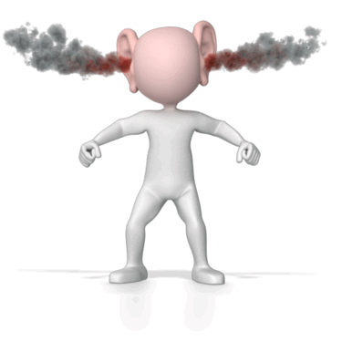
What Constitutes a Complaint?
Any expression of dissatisfaction with any aspect of the workplace?
An allegation indicating a violation of Company policies?

Slide 7
Why Investigate
Employee Complaints?
?
?
It is the right thing to do
?
Ensures adherence to the Company’s policies
?
?
?
Builds respect & trust in the workplace
?
?
Reduces risk of employment litigation
?
Presents opportunity to correct problems before they escalate
?
?
Better decision-making
?
?
?
?
Provides effective defense in litigation
?

Slide 8
How Can We Receive
Notice of a Complaint?
Govt
Agency (EEOC, DOL, etc.
Internal complaint (written or verbal)
Lawsuit
Informal reports
Compliance Guideline
Complaint letter
Exit interview
Anonymous letters,
e-mails messages
Union/
ULP
Observation

Slide 9

What About
“Off the Record” Complaints?
There is no such thing as an “off the record” complaint
The employer cannot conduct a “secret” investigation
Think “discretion,” not “confidentiality”

Slide 10

What if the Conduct Stops Before Investigation Begins or Complainant Does Not Want to Proceed?
Thank goodness! (No)
No need to investigate (No)
Investigate only if the employee agrees (No)
Employer must go forward with the investigation (Yes)

Slide 11
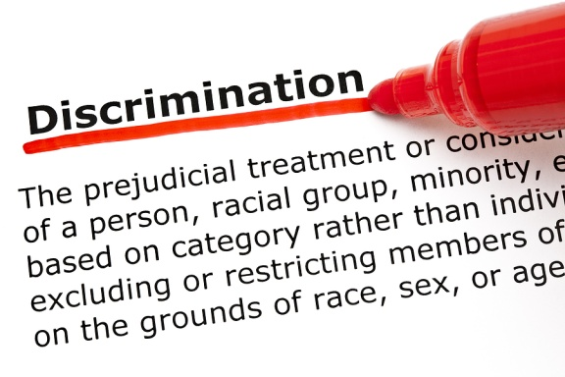

Investigations and
Legal Considerations
Discrimination/Retaliation
Privacy Issues
NLRA Implications
Tort Claims
Affirmative Defense to Harassment

Slide 12

Investigations and
Legal Considerations
The Attorney-Client Privilege
    Elements:
      A communication
      Made between privileged persons
      In confidence
      For the purpose of obtaining or providing legal assistance for the client
Attorney Work Product
    Elements:
      In anticipation of litigation
      Prepared by or for an attorney

Slide 13
Eight Steps to
Conducting the Investigation
1
Prepare an investigative work plan
2
Review the applicable documents
3
DOCUMENT and retain investigative records
4
Interview the complainant(s)

Slide 14
Eight Steps to Conducting the Investigation
5
Interview the witnesses
6
Interview the alleged wrongdoer
7
Evaluate Facts
8
Finalize the investigation

Slide 15
Prepare An Investigative
Work Plan
1
  Review the complaint
  Determine who should conduct the investigation
  Determine the focus and goal of the investigation
  Identify the witnesses
  Identify the documents to be reviewed
  Prepare for the interviews
  Decide the preliminary order of interviews
  Prepare a rough outline or checklist for each interview

Slide 16

Take Any Necessary
Immediate Action
    Separate employees involved? (schedule changes, LOA, etc.)
    Threat of imminent harm?
    Compromising investigation?
    Caution: retaliation against complainant
    Consider suspension
    Consider change in supervisory duties

Slide 17
Determine Who Will Conduct
The Investigation
Human Resources
Legal Counsel
Outside Third Party
Consider potential conflicts of interest

Slide 18
The Investigator Selected Must:
  Be credible, objective, and impartial
  Understand the purpose of the investigation
  Understand the time constraints
  Know the issues to be addressed
  Know the company’s policies, procedures, practices, and rules
  Possess good interviewing skills
  Able to prepare an accurate and complete record
  Able to maintain confidentiality (“need-to-know” basis)
  Know applicable employment laws
  Be an effective witness in future legal proceedings

Slide 19
Determine Who/Where to Interview
WHO:
  May be subject to change as interviews progress
  Most common order of interviews:
        The complainant
        Key witnesses
        The respondent (accused)
        Other witnesses identified by the complainant and the respondent or who observed or possess knowledge of the incident(s)
WHERE:
  Best practice: in person interviews
  Identify a location that allows for privacy and security
  Allow sufficient time between the interviews to properly document and to avoid any uncomfortable interactions between interviewees

Slide 20

Identify Relevant Documents
  Applicable policies and practices (harassment, work rules, progressive discipline)
  Background information
    History of improper conduct
    Similar complaints in the past
    Motives/biases (e.g. poor evaluation)
  Factual information such as letters, emails, voicemail messages, calendars, Internet history, text messages, computer hard drives, etc.

Slide 21
Identify Relevant Documents
Determine Whether/How to Use Social Media
Legal and Ethical Considerations re: Access:
  International Privacy Concerns
  State laws restricting use
  Federal laws restricting improper access
Legal Considerations re Use:
  NLRB

Slide 22

Prepare Rough Outline/Checklist for the Interview
Each situation demands different questions, since the elements of each problem are rarely the same.
Each witness will need to answer questions relating to what they saw, when they saw it, who was there, why something happened (if known), what happened next, and so on.
The investigator must be capable of thinking of new questions on the spot to follow up on information given by the witness(es).

Slide 23
Standardize the Interview Process
Where Possible - Beginning
  Purpose
    Identify your role as an investigator and fact finder
    Advise that the purpose of the meeting is to determine if a violation of Company policy has occurred
  Cooperation
    Emphasize that the Company requires cooperation, answering questions honestly and fully
  No Retaliation
    Advise interviewee that it is against the Company’s policy and illegal in some instances for anyone to retaliate against a person for making a complaint. If interviewee believes he/she has been subject to retaliation, they need to immediately notify you.
  Explain the reason for the interview (alleged act)
  Confidentiality

Slide 24

Standardize the Interview Process Where Possible - Ending
Review facts/notes
Are there any documents, e-mails, etc. that you think I should review?
  Why are those items relevant to this claim (if not obvious)
Are there any employees that you know of who have relevant information?
  Who are they and what information do you think they have?
Have we discussed all of the key information relating to this complaint/your response?
Would you like to change or correct anything that you have told me?
Is there anything else you would like to add?

Slide 25
Standardize the Interview Process Where Possible - Ending
Advise possibility of follow-up interview and avenues to relay additional information
    If you remember anything else/different, let me know immediately
Reinforce no retaliation and avenues to report retaliation
Acknowledge the witness for his/her participation
Leave the door open for follow-up communications
Note the length of the interview, including when interview began and ended
Note where the interview took place and all present; include your name as the author of the notes
    Jane Smith’s Interview of John Doe, 1pm on 12/12/12; HR Conference room; Jane Doe present

Slide 26
Review the
Applicable Documents
    Determine the relevancy of documents
    Determine if documents are “missing” (e.g., a letter without a response; email without an attachment)
    Determine who prepared the documents and why
2

Slide 27

Potential Documents to Review
Policies, Procedures, etc.
Relevant investigation files
Relevant complaints
Personnel files of the individuals involved
Emails & attachments, attendance records, etc.
Other relevant business records

Slide 28
Document and Retain
Thorough Records
3
  Maintain accurate records of information received from complaining employee, witnesses and alleged wrongdoer

Slide 29

Documentation
Document each interview and, when appropriate, have the interviewee sign a statement
Separate notes for each interview
Separately record observations and evaluation of credibility. Caution: may be discoverable
Tell accused of each allegation
Ask the tough questions, but save embarrassing and unfriendly questions for the end to avoid witness becoming defensive and less open
Be patient, allow witnesses to respond.
Write key statements literally in quotes

Slide 30
Documentation
Effective note taking includes:
    Preparer’s names, date/time of interview, all present
    Close to verbatim/use quotes
    Identify those present, date, time, location
    Record Qs & As
    Review and affirmation of information
    Based on fact – not opinion or speculation
    Reference specific issues, policies
    Include dates, times, chronology of events
    Statements are critical

Slide 31
Documentation
Effective note taking does not include:
    Interpretations of the interviewer
    Negative comments about the witness
    Assumptions or guesses
    Backdating
    Conclusions

Slide 32
Document and Retain
You must retain ALL investigative materials
      Do not discard drafts or working notes
      Keep an organized file
      Date your interview notes
      Keep a chronology
      Attorneys know what to look for and they will ask for it!
      Implications of destroying documents
Be familiar with the company’s retention policies/notices

Slide 33
Interview the Complainant
    Interview as soon as practicable
    Decide on how you want to handle situation if Complainant wants to have his/her attorney present during the interview.
    At the interview, cover Standardized Beginning of Interview
    Ask prepared questions
    Ask him/her to confirm the accuracy of the interview
    Is there anything else I should know?
    Ask what outcome he/she would like from the process
    Cover Standardized ending of interview
4

Slide 34

Interview the Complainant
Give opportunity to explain complaint in detail
Listen to and take careful notes of the employee’s concerns.
Do not be concerned with how the employee characterizes the behavior
Reserve judgment
After getting a general description of the complaint:
    Who? What? When? Where? Others with similar experiences? Number of occurrences? Witnesses?

Slide 35
Interview the Complainant
Ask the employee about his/her knowledge about the work place policies and whether the employee took other action in an attempt to remedy issues
Explain that you may need to meet again to ask follow-up questions
Notify the employee that retaliation will not be tolerated and inform employee who he/she should notify
Ask the employee what action he/she might like to see in response
Ask if employee believes he/she can continue to work with the accused

Slide 36
Interview DON’Ts:
Do not suggest answers or interrupt
Do not act partial to one side
Do not mistreat interviewee
Do not make accusations or threats
Do not allow distractions
Do not assume information is true simply because it is corroborated by another person
Do not make promises, obligations or private deals
Do not tape record (unless express approval from Legal Dept.)

Slide 37

What If One Claim Reveals Various Other Claims?
Handling detours – new allegations which cloud the old
Consider separate investigation

Slide 38
Interviewing Witnesses
5
    Standard Beginning
    Ask prepared questions
    Ask him/her to confirm the accuracy of the interview
    Is there anything else I should know?
    Standard Ending

Slide 39
Interviewing Witnesses
Explain generally what is being investigated, seriousness of matter.
Explain the allegations (only as needed); you may choose to keep the complainant’s name confidential.
Determine whether to provide witness with factual background
    Don’t share what other witnesses have said unless necessary.
Do not discuss your opinions and conclusions with witnesses
NEVER conduct witness interviews in groups

Slide 40
Interviewing Witnesses
Must diplomatically “pin” witness down on facts; use quotes!
    Distinguish between first- and third-hand knowledge.
        What do they know? Source?
        Notes? Recordings? Evidence?
Avoid conclusions, focus on facts; if witness concludes, ask why?
Avoid “yes” and “no” questions – get witness to talk!
Advise witness, if appropriate, not subject of investigation.
No retaliation for cooperation.
Standard Ending

Slide 41
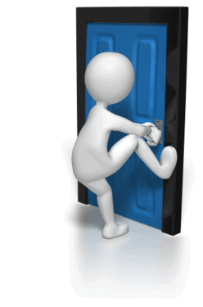
Interviewing Witnesses
What do you do with uncooperative witnesses?
    Attempt to establish rapport and explain the investigative process in some detail
    Inquire as to the reasons for not cooperating
    Document the witness’ refusal to cooperate
What do you do if witness wants to terminate interview?
    “I am not telling you anything.”
    “That’s personal and none of your business.”
    “I want a lawyer.”
    “I don’t know anything; didn’t hear anything.”

Slide 42
Interviewing Accused
    Standard Beginning
    Ask prepared questions
    Discuss each allegation in sufficient detail to enable a full response
    Ask him/her to confirm the accuracy of the interview
    Is there anything else I should know?
    Standard Ending
6

Slide 43
Interviewing Accused
Review specific allegations and ask for and document employee’s response – ask open ended questions. You do not need to disclose the source of all of your information, but you must describe the allegations sufficiently to enable a response.
Avoid the tendency to either assure employee that the claims will be dismissed or to assume that the employee is guilty of the conduct alleged.
Get exact descriptions of words used, actions taken, etc.
If employee denies the allegations, ask why he/she thinks complaining party may have made them.
Prepare to ask the same question in several different ways.

Slide 44
Interviewing Accused
Observe body language, voice tone, physical activity and word usage. Critical for credibility. Record in notes.
Advise the employee that he/she must not discuss the claim with the complainant.
Advise the employee that if the results of the investigation find that inappropriate conduct occurred, the employer will take prompt and remedial action.
Remind employee – no retaliation, explain exactly what you mean.
Conclude with the standard ending.
    Re-interviewing the complainant, witnesses and/or accused may be necessary to ensure accurate facts and information.

Slide 45
Evaluate Evidence
7
    Carefully analyze the information obtained and draw reasoned and logical conclusions.

Slide 46

Evaluate Evidence
    Establish whether the evidence obtained is sufficient to establish in good faith that a violation of the Company’s policies did or did not occur
    Determine if there are systemic problems that may result in perceptions of violations that are not factual
    Understand that investigation may reveal conflict/behavior which is not a violation of the Company’s policies.
    Evaluate how your company has handled previous similar situations
    Consider how did complainant want the matter resolved
        Include rationale for implementing or discarding options.

Slide 47
Factors to Determine Credibility
    Consider credibility of each party and witness
      Inherent plausibility: Is the testimony believable on its face? Does it make sense?
      Demeanor: Did the person seem credible or untruthful?
      Motive to falsify: Did the person have a reason to lie? Is this a set-up?
    Corroboration
      Is there witness testimony (eye-witnesses)?
      Is there physical evidence (written documentation)?
    Past record
      Did the alleged wrongdoer or complainant have a history of similar behavior in the past?

Slide 48

What Do I Do About….
Hearsay
Rumor
Opinion (not backed by facts)

Slide 49

WHAT DO YOU DO IF YOU CANNOT TELL WHO IS TELLING THE TRUTH?

Slide 50

Findings
We were unable to substantiate the allegations made by complainant.

Slide 51

Proper or Improper?
John said Susan tried to kiss him twice in the inventory room. He stated he could not recall the dates. He said he never told anyone that Susan tried to kiss him. He said he kissed Susan back on one occasion. He stated he was flattered by Susan’s actions and they did not bother him.
vs.
Susan kissed Brian two times. Susan is his manager. This is sexual harassment! Possible quid pro quo?

Slide 52
Proper or Improper?
  Tonya said she never sent an inappropriate email from work. She paused for several seconds and looked down at the table. She then said she may have sent a cartoon to one of her co-workers once. I placed a copy of the email pulled from Tonya’s sent folder on the table. Tonya began to cry.
  vs.
  Tonya denied sending bad emails. When I put her email on the table, it became clear she lied.

Slide 53
Finalize the Investigation
8
    Analysis & summary of the allegations
    Conclusion/ Recommendation

Slide 54

Analysis
    Methodology:
      ID parties and witnesses
      ID issue(s) and how documented
      ID dates/times of interviews
      ID investigators
      ID relevant policies, etc.
      ID materials reviewed
    Analysis:
      Inconsistencies vs. corroborated facts
      Credibility role/assessments
      Role of motive/bias, if any
      Ethnicity and other considerations
      What “you” determine happened
      If the claim alleges violation of Company policy, use the language from the policy as your guide

Slide 55
Conclusion/Recommendation
      Set forth your conclusion and recommended course of action.
      Do not use knowledge of employment laws as the basis for your conclusions. Judges and juries decide whether there has been a violation of the law.
      Never make legal conclusions

Slide 56

Close the Investigation
Advise those at within the company that have a “need to know” of outcome.
Advise the parties of the outcome. Decide on whether it will be verbal, in writing, or both
    Complainant ordinarily should not be informed of specifics of discipline imposed on accused.
    Rather, Complainant should be advised that the matter has been investigated and that appropriate action has been taken and it is expected that the conduct will not reoccur
Implement prompt course of remedial action, if appropriate.
Follow-up with Complainant to assure conduct has stopped, no reprisal

Slide 57
Finalize Documents
Mark all investigative material:
    Confidential
    Confidential Work Product Prepared in Anticipation of Litigation
    Confidential Attorney/Client Communication
      Do not show the witness confidential or privileged documents
      Keep all investigation files separate from personnel files of witnesses
If applicable, remove litigation hold after reasonable time, following discussion with Legal if appropriate.

Slide 58
After the Investigation is Completed . . .
Do not discuss any information obtained during the investigation except on a “need-to-know” basis

Slide 59

Questions?

Slide 60
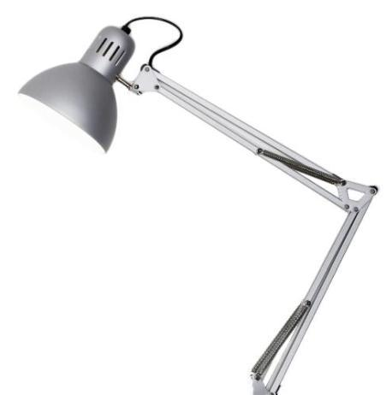

Thank You!
Workplace law. In five time zones and 55 major locations coast to coast.

