Slide 1
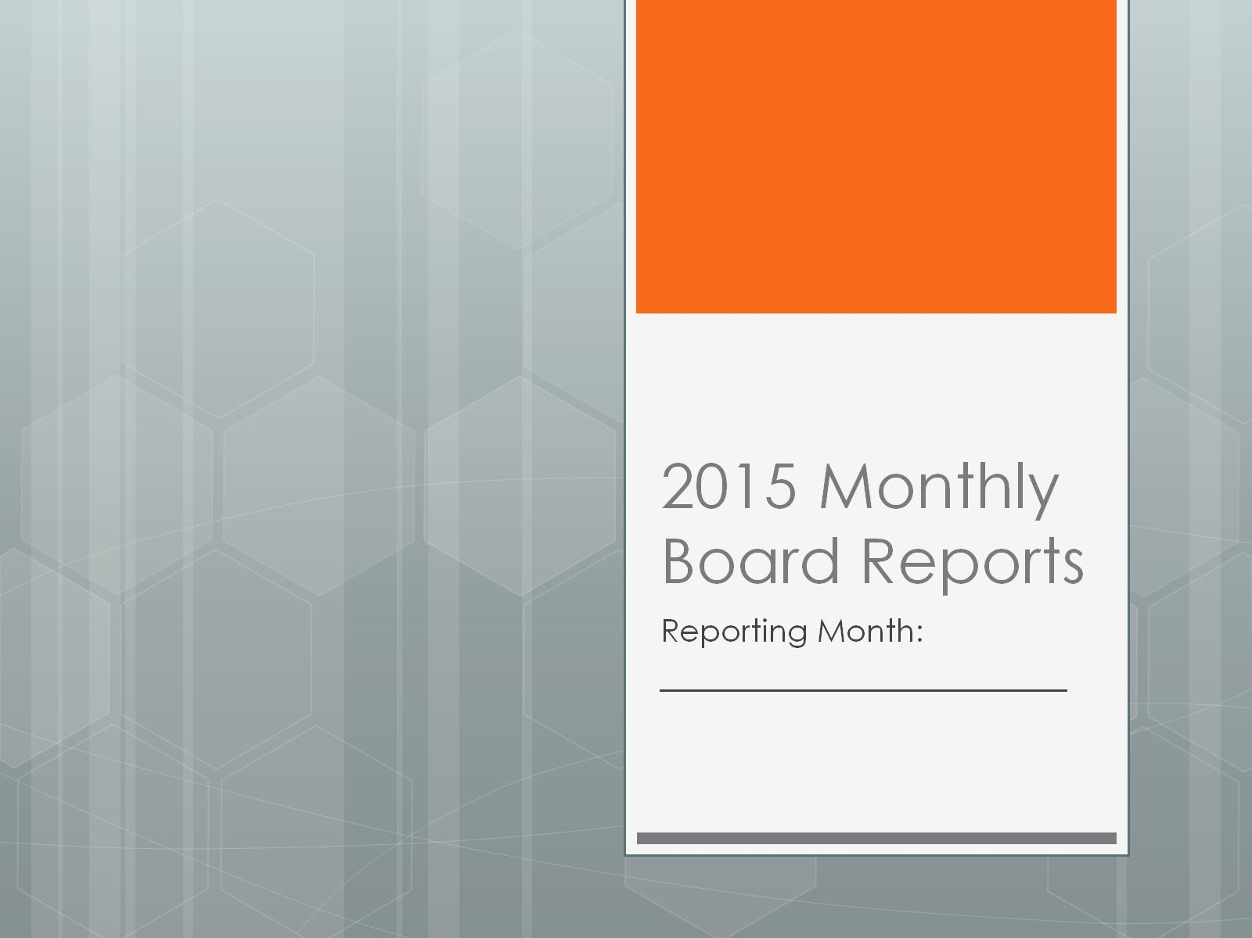
2015 Monthly Board Reports

Slide 2
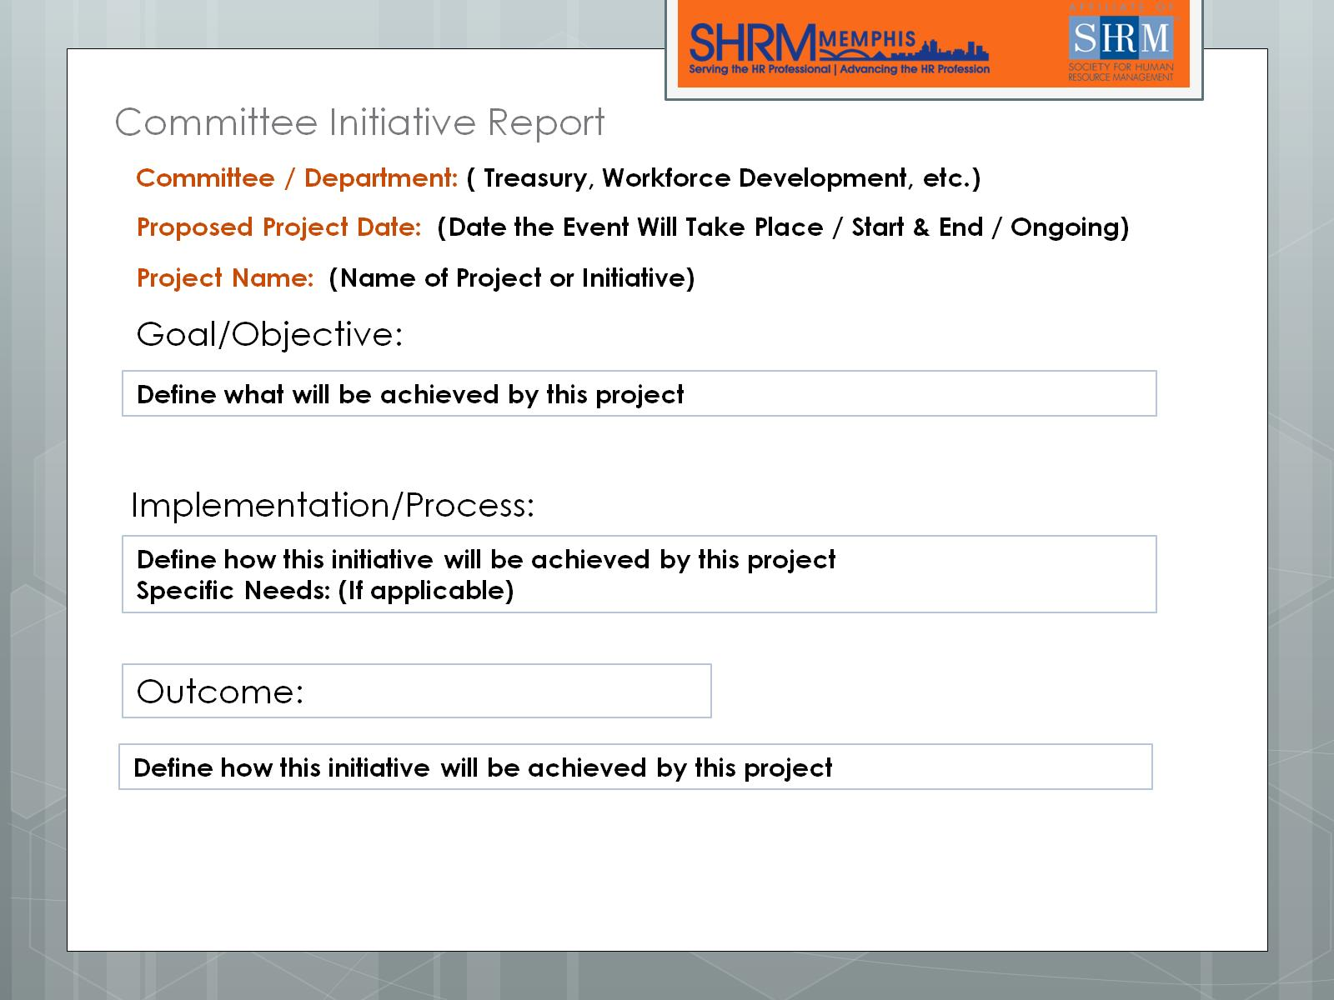
Committee Initiative Report

